Slide 1
Introduction to Radiosity
Andries van Dam, John F. Hughes
Applets by Nick Diakopoulos
11/28/2012

Slide 2
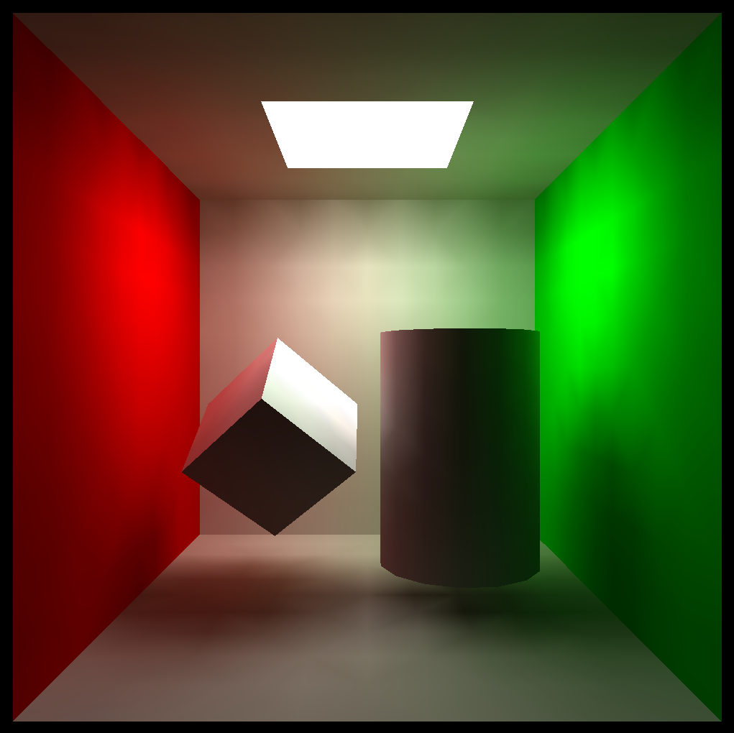
Radiosity for Inter-Object Diffuse Reflection
No Ambient Hack
View Independent
Came from thermal engineering and now used in other areas of engineering
Color Bleeding
Soft Shadows
11/28/2012

Slide 3
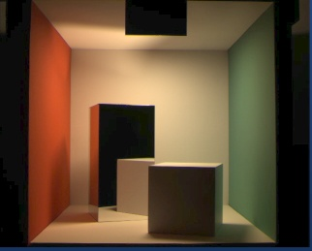
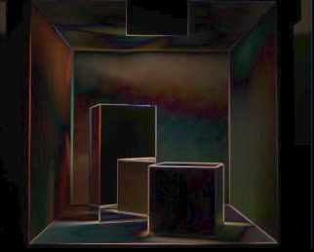
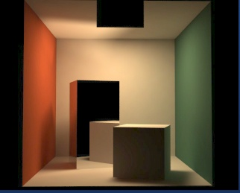
Pretty Pictures (the “Cornell Box”)
Reality (actual photograph)…
Minus Radiosity Rendering…
Equals the difference (or error) image
11/28/2012
http://www.graphics.cornell.edu/online/box/compare.html

Slide 4
The Radiosity Technique: An Overview (1/2)
Model scene as “patches”
Each patch has an initial luminance value: all but luminaires (light sources) are probably zero
Iteratively determine how much luminance travels from each patch to each other patch until entire system converges to stable values
We can then render scene from any angle without recomputing these final patch luminances—based solely on inter-object reflection and thus viewer independent!
11/28/2012

Slide 5
The Radiosity Technique: An Overview (2/2)
The term radiosity means rate at which energy leaves a surface
Sum of rates at which surface emits energy and reflects (or transmits) energy received from all other surfaces
Radiosity simulations are based on thermal engineering model of emission and reflection of radiation using finite element approximations of geometry (FEM closely related to meshing)
First determine all light interactions in a view-independent way, then render one or more views.
Consider room with only floor and ceiling:
Suppose ceiling is actually a fluorescent drop-panel ceiling which emits light…
Floor gets some of this light and reflects it back
Ceiling gets some of this reflected light and sends it back…
Simulation mimics these successive “bounces” through a mathematical model involving attenuation and repeated reflection – sum of energies approaches limit fairly quickly
11/28/2012

Slide 6
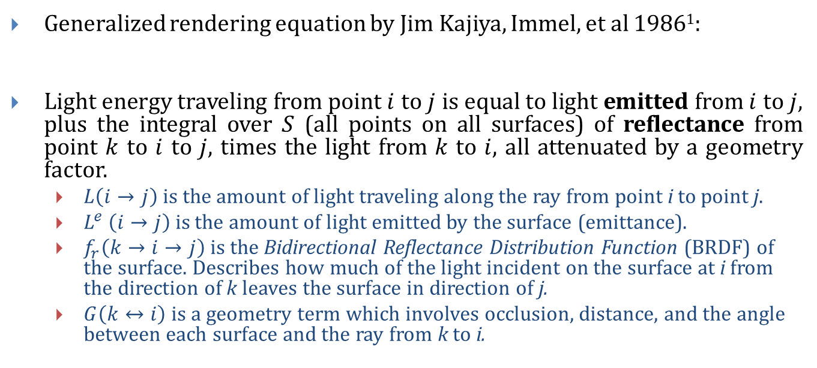
Kajiya’s Rendering Equation – energy balance (1/2)
Generalized rendering equation by Jim Kajiya, Immel, et al 1986¹:
Light energy traveling from point $i$ to $j$ is equal to light emitted from $i$ to $j$, plus the integral over $S$ (all points on all surfaces) of reflectance from point $k$ to $i$ to $j$, times the light from $k$ to $i$, all attenuated by a geometry factor.
$L\left(i→j\right)$ is the amount of light traveling along the ray from point i to point j.
$L^{e}$ $\left(i→j\right)$ is the amount of light emitted by the surface (emittance).
$f_{r}\left(k→i→j\right)$ is the Bidirectional Reflectance Distribution Function (BRDF) of the surface. Describes how much of the light incident on the surface at i from the direction of k leaves the surface in direction of j.
$G\left(k↔i\right)$is a geometry term which involves occlusion, distance, and the angle between each surface and the ray from k to i.
¹J Kajiya. “The Rendering Equation.” SIGGRAPH 1986, pp. 143-150
11/28/2012

Slide 7
Kajiya’s Rendering Equation – energy balance (2/2)
More complete model of light transport than either raytracing or polygonal rendering, but omits effects, e.g., subsurface scattering, phosphorescence and fluorescence, etc.
How do we evaluate this function?
Very difficult to solve complicated integral equations analytically
So we approximate, in forward direction (stochastic methods) or backward direction (raytracing)
11/28/2012

Slide 8
Rendering a Scene
A scene has: geometry, luminaires (light sources), observation point (camera)
Light transport to camera must be computed for every incoming angle to observation point, bouncing off all geometry (in all directions combined)
This is far too hard
Both ray tracing and radiosity are crude approximations to rendering equation
Ray tracing: consider only a very small, finite number of (specular reflection and refraction) rays and ignore diffuse inter-object reflections, typically using ambient hack to approximate that lost component. Can use either a computed or measured BRDF or a simpler model (e.g., Phong lighting)
Radiosity: approximate integral over differential source/sender areas dA(i) with finite sum over finite areas; consider light transport not on basis of individual rays but rather on basis of energy transport between finite patches (e.g., quads or triangles that result from meshing)
11/28/2012

Slide 9
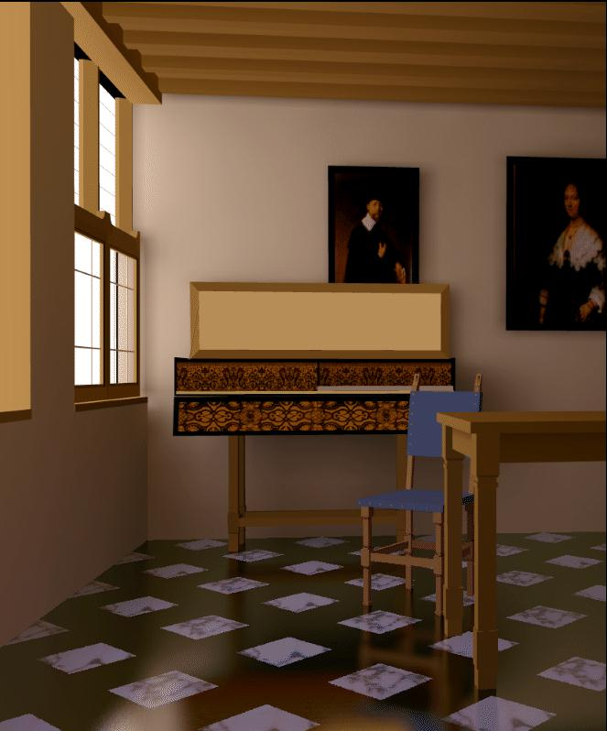
Ray Tracing vs. Radiosity
More accurate than strictly local/direct lighting model, but accuracy is relative
hall of mirrors is largely specular → ray tracing does better
museum with latex-painted walls is diffuse → radiosity does better
Ray tracing and Radiosity both approximate BRDF function by leaving out contributions of incoming rays to a surface point. Ray tracing can use full BRDF, but in its simplest form, uses only specular component of BRDF for reflection rays.
Radiosity doesn’t evaluate specular components. Instead, approximates global diffuse inter-object reflection by considering how each pair of patches send and receive light energy, an O(n²) operation best accomplished by progressive refinement.
Best solutions are hybrid techniques: use ray tracing for specular components and radiosity for diffuse components.
11/28/2012

Slide 10
Radiosity Formulation (1/2)
Amount of light/radiosity/energy a patch i finally emits is initial emission plus sum of emissions due to other n-1 patches in scene emitting to this patch: recursive definition. Note: E_{i} is non-zero only for luminaires.
Energy = light energy = radiosity for our purposes – but it should really be rate, i.e., energy/unit time…
Sender₂
Sender₁
…
Sender_{n}
Receiver, patch_{i}
11/28/2012

Slide 11
Radiosity Formulation (2/2)
B_{i}: final amount of energy radiating from i’th patch – unknown to be computed
E_{i}: initial amount of energy radiating from i’th patch (non-zero for luminaires)
B_{j}: final amount of energy radiating from j’th patch
F_{j-i}: fraction (proportion) of energy B_{j} emitted by j’th patch that is gathered by i’th patch (geometric relationship between i’th and j’th patches : distance, relative angles between patches, and patch size, a fraction called form factor)
F_{j-i} B_{j}: total amount of patch j's energy sent to patch i
ρ_{i}: fraction of incoming energy to a patch that is then exported in next iteration (related to diffuse reflection coefficient, k_{d}, in simple illumination model, i.e., how absorbing vs. reflecting the material is – typically small)
11/28/2012

Slide 12
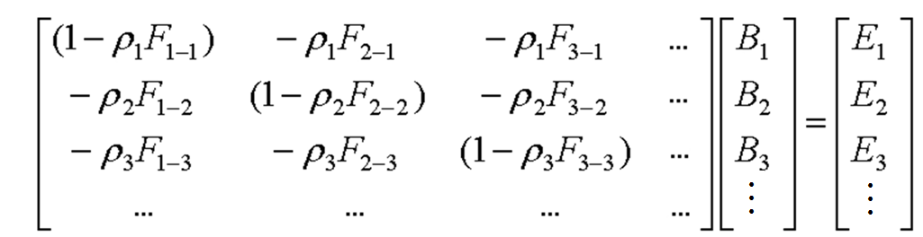
Let’s Rearrange Those Symbols (1/2)
Sender₂
Sender₁
…
Sender_{n}
From previous slide:
Receiver, patch_{i}
or
Thus:
Rewrite as a vector product:
And the whole system:
11/28/2012

Slide 13
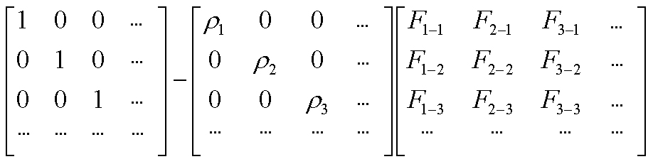
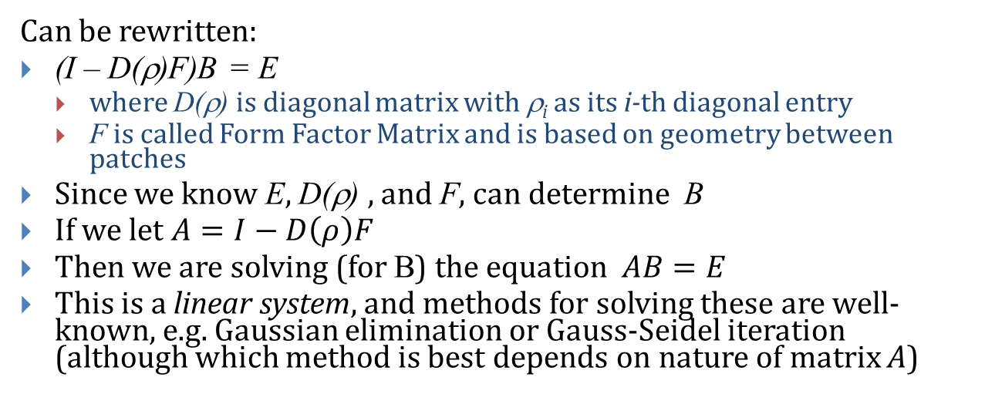
Let’s Arrange Those Symbols (2/2)
Decompose the first matrix as:
Can be rewritten:
(I – D(ρ)F)B = E
where D(ρ) is diagonal matrix with ρ_{i} as its i-th diagonal entry
F is called Form Factor Matrix and is based on geometry between patches
Since we know E, D(ρ) , and F, can determine B
If we let $A=I−D\left(ρ\right)F$
Then we are solving (for B) the equation $AB=E$
This is a linear system, and methods for solving these are well-known, e.g. Gaussian elimination or Gauss-Seidel iteration (although which method is best depends on nature of matrix A)
11/28/2012

Slide 14
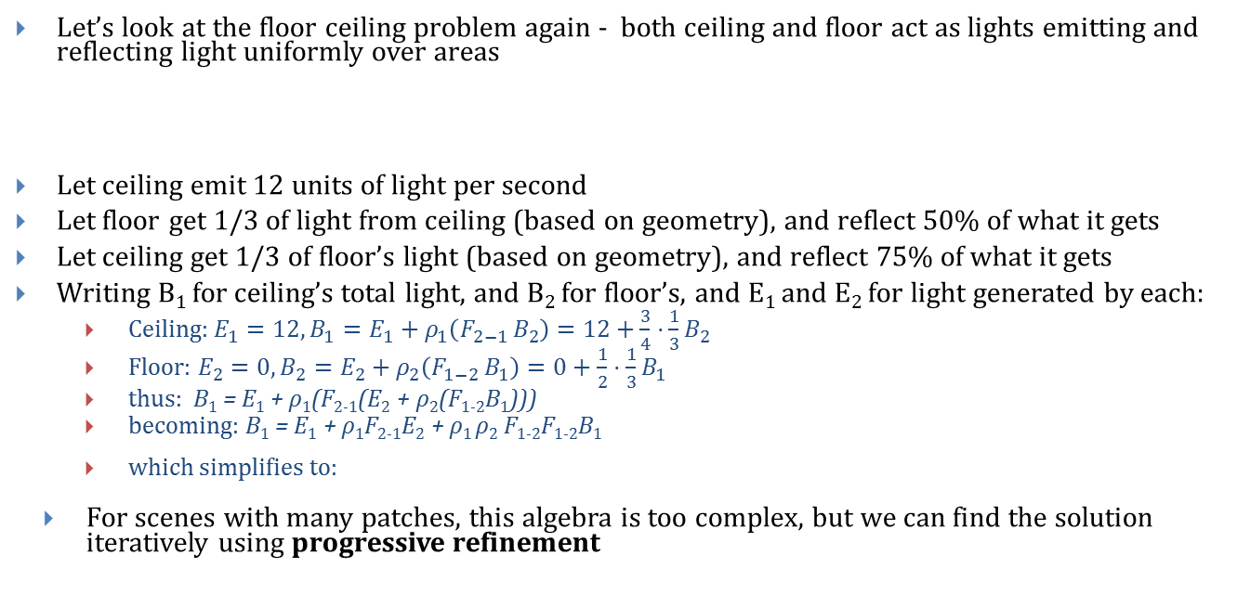
Progressive Refinement (1/2)
Let’s look at the floor ceiling problem again - both ceiling and floor act as lights emitting and reflecting light uniformly over areas
Let ceiling emit 12 units of light per second
Let floor get 1/3 of light from ceiling (based on geometry), and reflect 50% of what it gets
Let ceiling get 1/3 of floor’s light (based on geometry), and reflect 75% of what it gets
Writing B₁ for ceiling’s total light, and B₂ for floor’s, and E₁ and E₂ for light generated by each:
Ceiling: $E_{1}=12, B_{1}=E_{1}+ρ_{1}\left(F_{2−1 }B_{2}\right)=12+\frac{3}{4}⋅\frac{1}{3}B_{2}$
Floor: $E_{2}=0, B_{2}=E_{2}+ρ_{2}\left(F_{1−2 }B_{1}\right)=0+\frac{1}{2}⋅\frac{1}{3}B_{1}$
thus: B₁ = E₁ + ρ₁(F₂₋₁(E₂ + ρ₂(F₁₋₂B₁)))
becoming: B₁ = E₁ + ρ₁F₂₋₁E₂ + ρ₁ ρ₂ F₁₋₂F₁₋₂B₁
which simplifies to:
For scenes with many patches, this algebra is too complex, but we can find the solution iteratively using progressive refinement
C emits 12
C reflects 75%
F gets 1/3 C
F reflects 50%
C gets 1/3 F
11/28/2012

Slide 15
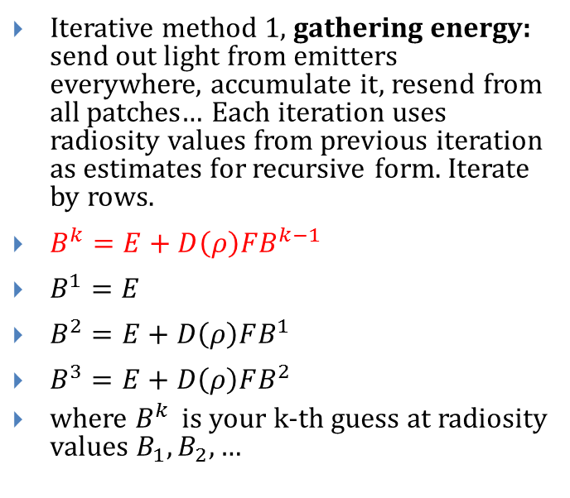
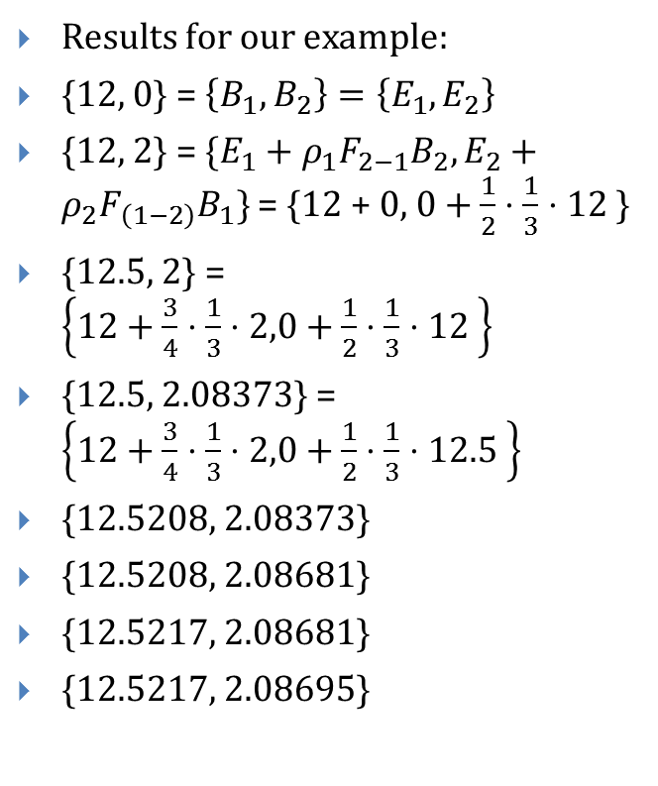
Progressive Refinement (2/2)
Iterative method 1, gathering energy: send out light from emitters everywhere, accumulate it, resend from all patches… Each iteration uses radiosity values from previous iteration as estimates for recursive form. Iterate by rows.
$B^{k}=E+D\left(ρ\right)FB^{k−1}$
$B^{1}=E$
$B^{2}=E+D\left(ρ\right)FB^{1}$
$B^{3}=E+D\left(ρ\right)FB^{2}$
where $B^{k }$is your k-th guess at radiosity values $B_{1}, B_{2}, …$
Results for our example:
{12, 0} = $\left\{B_{1},B_{2}\right\}=\left\{E_{1},E_{2}\right\}$
{12, 2} = $\{E_{1}+ρ_{1}F_{2−1}B_{2},E_{2}+ρ_{2}F_{\left(1−2\right)}B_{1}\}$ = {12 + 0, $0+\frac{1}{2}⋅\frac{1}{3}⋅12$}
{12.5, 2} = $\left\{12+\frac{3}{4}⋅\frac{1}{3}⋅2,0+\frac{1}{2}⋅\frac{1}{3}⋅12 \right\}$
{12.5, 2.08373} = $\left\{12+\frac{3}{4}⋅\frac{1}{3}⋅2,0+\frac{1}{2}⋅\frac{1}{3}⋅12.5 \right\}$
{12.5208, 2.08373}
{12.5208, 2.08681}
{12.5217, 2.08681}
{12.5217, 2.08695}
11/28/2012

Slide 16
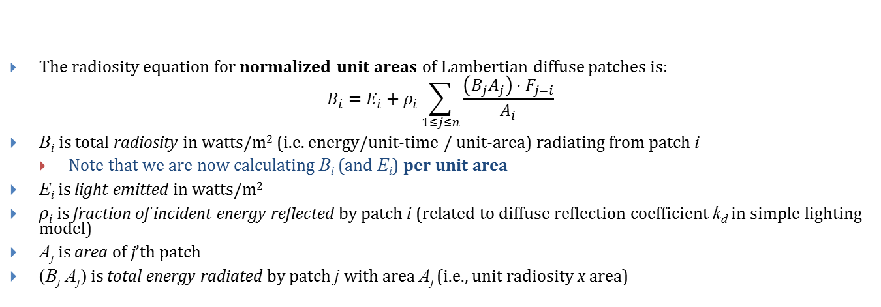
Generalized Radiosity Equation (1/3)
Sender₂
…
Sender₁
Sender_{n}
Receiver
The radiosity equation for normalized unit areas of Lambertian diffuse patches is:
$$B_{i}=E_{i}+ρ_{i}\sum_{1≤j≤n}{\frac{\left(B_{j}A_{j}\right)⋅F_{j−i}}{A_{i}}}$$
B_{i} is total radiosity in watts/m² (i.e. energy/unit-time / unit-area) radiating from patch i
Note that we are now calculating B_{i} (and E_{i}) per unit area
E_{i} is light emitted in watts/m²
ρ_{i} is fraction of incident energy reflected by patch i (related to diffuse reflection coefficient k_{d} in simple lighting model)
A_{j} is area of j’th patch
(B_{j} A_{j}) is total energy radiated by patch j with area A_{j} (i.e., unit radiosity x area)
11/28/2012

Slide 17
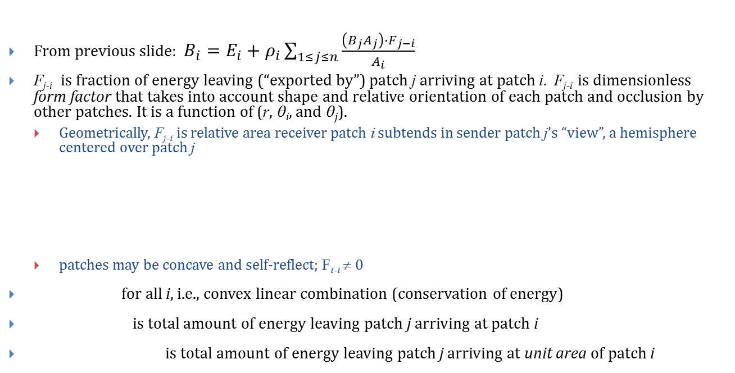
Generalized Radiosity Equation (2/3)
From previous slide: $B_{i}=E_{i}+ρ_{i}\sum_{1≤j≤n}{\frac{\left(B_{j}A_{j}\right)⋅F_{j−i}}{A_{i}}}$
F_{j-i} is fraction of energy leaving (“exported by”) patch j arriving at patch i. F_{j-i} is dimensionless form factor that takes into account shape and relative orientation of each patch and occlusion by other patches. It is a function of (r, θ_{i}, and θ_{j}).
Geometrically, F_{j-i} is relative area receiver patch i subtends in sender patch j’s “view”, a hemisphere centered over patch j
patches may be concave and self-reflect; F_{i-i} ≠ 0
for all i, i.e., convex linear combination (conservation of energy)
is total amount of energy leaving patch j arriving at patch i
is total amount of energy leaving patch j arriving at unit area of patch i
Receiver_{i}
θ_{i}
θ_{j}
Sender_{j}
11/28/2012

Slide 18
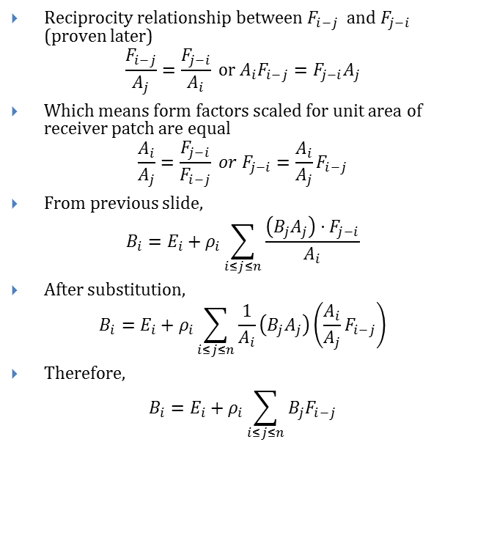
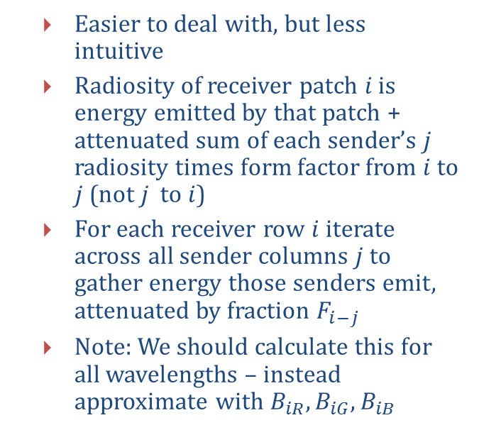
General Radiosity Equation (3/3)
Reciprocity relationship between $F_{i−j}$ and $F_{j−i}$ (proven later)
$$\frac{F_{i−j}}{A_{j}}=\frac{F_{j−i}}{A_{i}} or A_{i}F_{i−j}=F_{j−i}A_{j}$$
Which means form factors scaled for unit area of receiver patch are equal
$$\frac{A_{i}}{A_{j}}=\frac{F_{j−i}}{F_{i−j}} or F_{j−i}=\frac{A_{i}}{A_{j}}F_{i−j}$$
From previous slide,
$$B_{i}=E_{i}+ρ_{i}\sum_{i≤j≤n}{\frac{\left(B_{j}A_{j}\right)⋅F_{j−i}}{A_{i}}}$$
After substitution,
$$B_{i}=E_{i}+ρ_{i}\sum_{i≤j≤n}{\frac{1}{A_{i}}\left(B_{j}A_{j}\right)\left(\frac{A_{i}}{A_{j}}F_{i−j}\right)}$$
Therefore,
$$B_{i}=E_{i}+ρ_{i}\sum_{i≤j≤n}{B_{j}F_{i−j}}$$
Easier to deal with, but less intuitive
Radiosity of receiver patch $i$ is energy emitted by that patch + attenuated sum of each sender’s $j$ radiosity times form factor from $i$ to $j$ (not $j$ to $i$)
For each receiver row $i$ iterate across all sender columns $j$ to gather energy those senders emit, attenuated by fraction $F_{i−j}$
Note: We should calculate this for all wavelengths – instead approximate with $B_{iR}, B_{iG}, B_{iB}$
11/28/2012

Slide 19
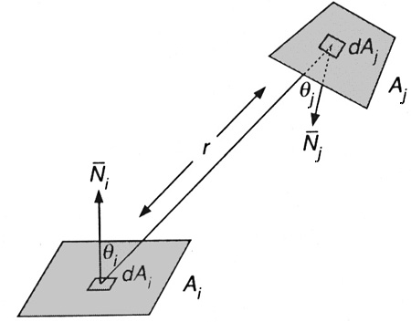
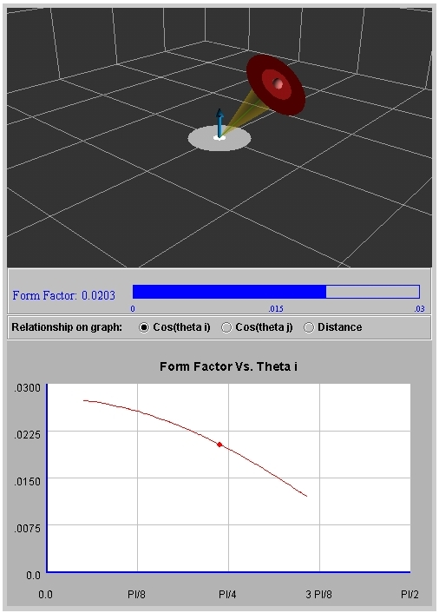
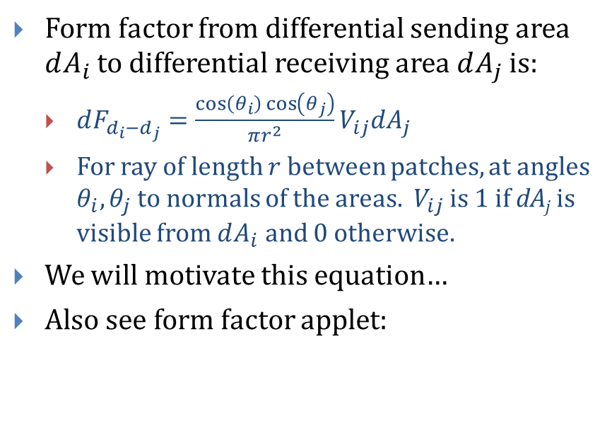
Computing Form Factors (1/7)
Receiver_{j}
Form factor from differential sending area $dA_{i}$ to differential receiving area $dA_{j}$ is:
$dF_{d_{i}−d_{j}}=\frac{\cos\left(θ_{i}\right)\cos\left(θ_{j}\right)}{πr^{2}}V_{ij}dA_{j}$
For ray of length $r$ between patches, at angles $θ_{i},θ_{j}$to normals of the areas. $V_{ij}$ is 1 if dA_{j} is visible from $dA_{i}$ and 0 otherwise.
We will motivate this equation…
Also see form factor applet:
Sender_{i}
Applet: http://www.cs.brown.edu/exploratories/freeSoftware/catalogs/lighting_and_shading.html
11/28/2012

Slide 20
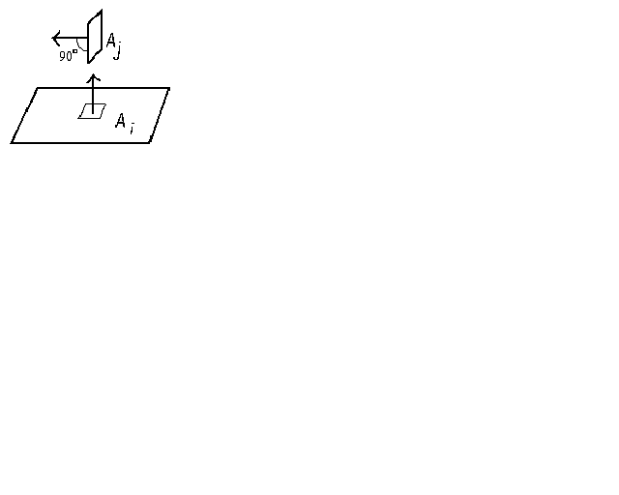
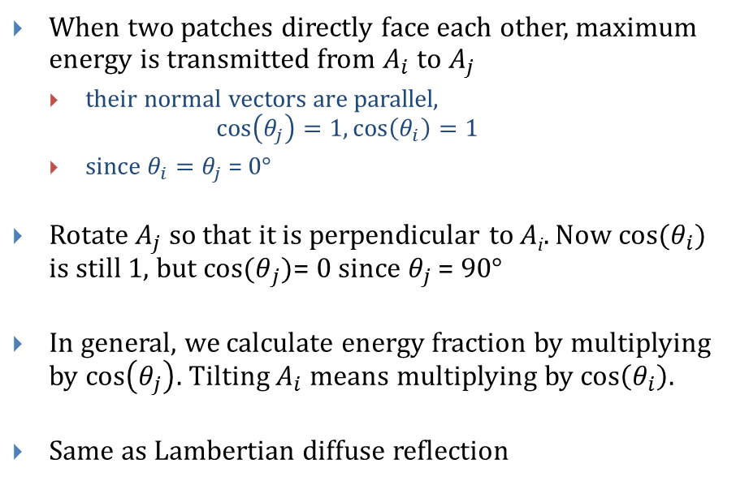
Computing Form Factors (2/7)
When two patches directly face each other, maximum energy is transmitted from $A_{i}$ to$A_{j}$
their normal vectors are parallel, $\cos\left(θ_{j}\right)=1, \cos\left(θ_{i}\right)=1$
since $θ_{i}=θ_{j}$ = 0°
Rotate $A_{j}$ so that it is perpendicular to A_{i}. Now cos${(θ}_{i})$ is still 1, but cos${(θ}_{j})$= 0 since $θ_{j}$ = 90°
In general, we calculate energy fraction by multiplying by $cos\left(θ_{j}\right)$. Tilting $A_{i}$means multiplying by $cos\left(θ_{i}\right)$.
Same as Lambertian diffuse reflection
11/28/2012

Slide 21
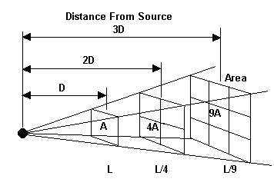
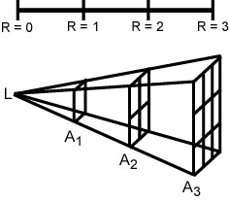
Computing Form Factors (3/7)
From where does the r² term arise? The inverse-square law of light propagation:
Consider patch A₁ – if P photons hit area A₁, their density is P/A₁. These same P photons pass through A₂. Since A₂ is twice as far from L, by similar triangles, it has four times the area of A₁. Therefore, each similar patch on A₂ receives 1/4 of the photons.
11/28/2012

Slide 22
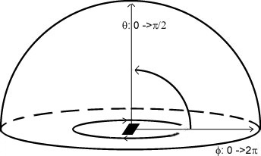
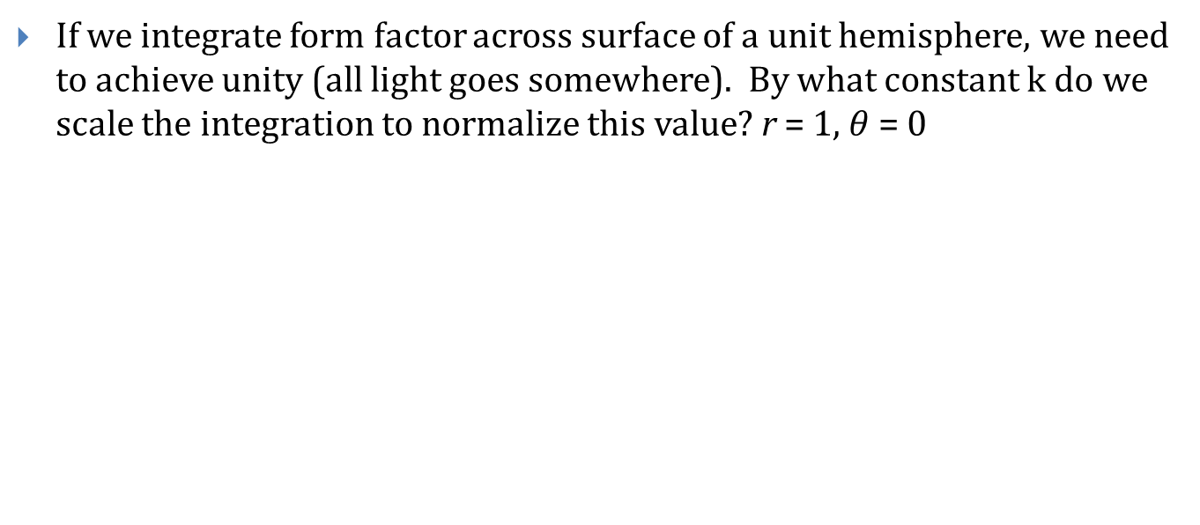
Computing Form Factors (4/7)
If we integrate form factor across surface of a unit hemisphere, we need to achieve unity (all light goes somewhere). By what constant k do we scale the integration to normalize this value? r = 1, $θ$= 0
11/28/2012

Slide 23
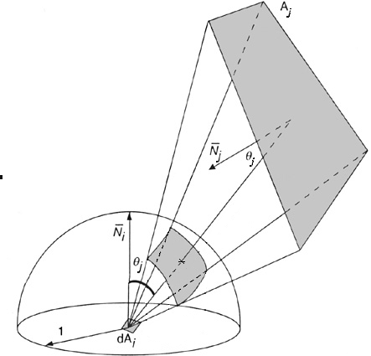
Computing Form Factors (5/7)
Consider a differential sender patch dA_{i} radiating to finite receiver patch A_{j}
F_{di-j ,} the form factor from differential area dA_{i} to finite area A_{j} , can be computed by projecting those parts of A_{j} visible from dA_{i} onto the unit hemisphere centered about dA_{i}.
Form factor is effectively the ratio of curved patch area to the total surface area of the hemisphere. It is a fraction.
Total surface area encompasses all energy emitted by dA_{i}
11/28/2012

Slide 24
Computing Form Factors (6/7)
This is an approximation! It only holds if dA_{j} is far from dA_{i}, so the angles θ_{i} and θ_{j} do not vary significantly across their respective patches
To determine F_{di-j}, the form factor from differential area dA_{i} to finite area A_{j}, we integrate over area of patch j:
V_{ij} again dictates visibility: V_{ij} = 0 implies occlusion
not trivial to resolve analytically for finite areas
Sometimes V_{ij} taken to be real number between 0 and 1
Send out number of ‘test rays’ between i and j
Percentage of rays that are not occluded by other objects determines V_{ij}
11/28/2012

Slide 25
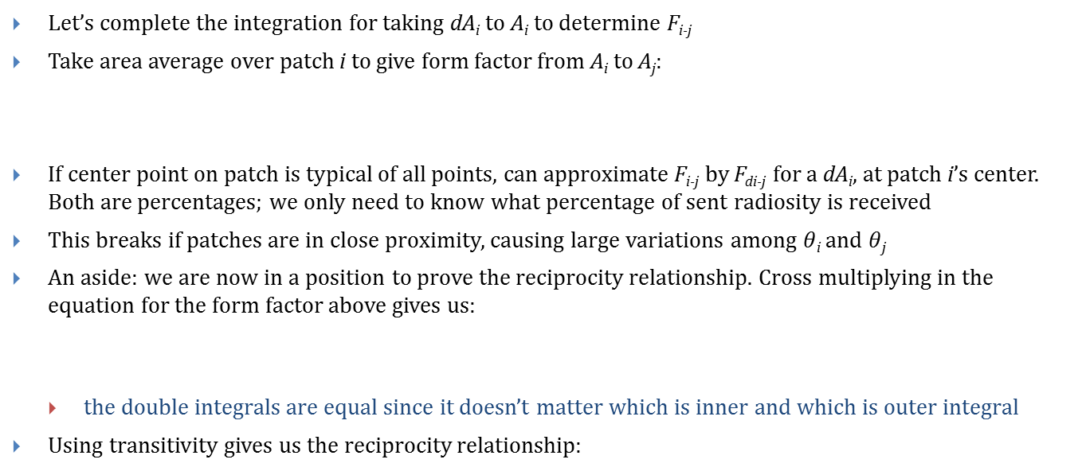
Computing Form Factors (7/7)
Let’s complete the integration for taking dA_{i} to A_{i} to determine F_{i-j}
Take area average over patch i to give form factor from A_{i} to A_{j}:
If center point on patch is typical of all points, can approximate F_{i-j} by F_{di-j} for a dA_{i}, at patch i’s center. Both are percentages; we only need to know what percentage of sent radiosity is received
This breaks if patches are in close proximity, causing large variations among $θ$_{i} and $θ$_{j}
An aside: we are now in a position to prove the reciprocity relationship. Cross multiplying in the equation for the form factor above gives us:
the double integrals are equal since it doesn’t matter which is inner and which is outer integral
Using transitivity gives us the reciprocity relationship:
11/28/2012
Notes:
cmo

Slide 26
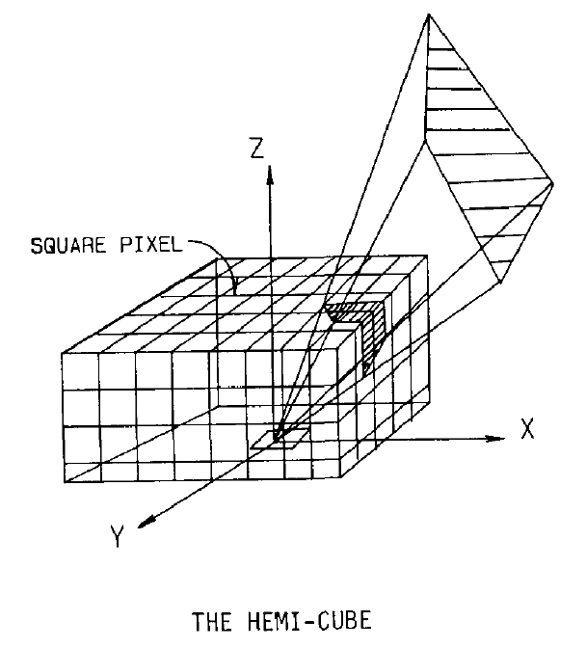
Approximating Form Factors (1/2)
Rather than projecting A_{j} onto a hemisphere, Cohen and Greenberg project it onto upper half of a cube centered about dA_{i}, with its top face parallel to surface.
Each face of the hemicube is divided into equal sized square cells.
Think of each face of cube as a film plane which records what a patch, dA_{i} , “sees” in each of the five directions; center of dA_{i} acts as COP.
In other words, think of cells on faces as pixels and use frustum formed by vertices of A_{j} to project A_{j} onto each face – just camera transform!
Now can use the projections as a proxy for the original A_{j}– simply divide the number of cells covered by each patch A_{j} by the total number
Cohen and Greenburg, 1985. The hemi-cube: a radiosity solution for complex environments. http://dl.acm.org/citation.cfm?id=325171
11/28/2012

Slide 27
Approximating Form Factors (2/2)
Identity of closest intersecting patch is recorded at each cell (survivor of z-buffer algorithm). Each hemicube cell p is associated with a precomputed delta form factor value.
θ_{p} is angle between p’s surface normal and vector of length r between dA_{i} and p; ΔA is area of cell
Can approximate F_{di-j} for any patch j by summing ΔF_{p} associated with each cell p covered by patch j’s hemicube projection
Provides occlusion determination of patches through z-buffer (albeit limited by the granularity/resolution of the cells on each plane)
This eliminates the need to compute V_{i-j}
End result: each cell on sender's hemicube is marked with the IDs of the patches that project onto that cell that are visible and non-occluded from the sender patch. Then divide the number of cells covered by each receiver patch by the total number of cells in the hemicube to get an approximation to the form factor.
11/28/2012

Slide 28
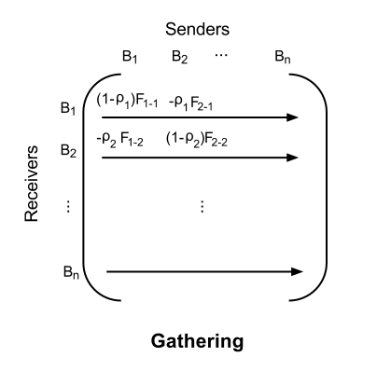
Faster Progressive Refinement: Shooting (1/2)
Once we’ve computed form factor matrix F, and knowing D(ρ) based on material properties for each patch, we can now solve the system of equations by Gauss-Seidel iteration
Gathering: process consecutive receivers (rows), for each receiver looping through each column/sender; all rows are processed for each iteration, updating display after all rows are processed
Shooting: shoot energy in order from brightest to least bright sender patch and update each receiver immediately, incrementally updating entire image after processing each shooter
iteratively shoot from patch that has largest amount of “unshot” radiosity
for a given patch, keep track of both its total radiosity and the total accumulated radiosity since the last time it shot
thus brightest luminaire shoots first; second shooter will either be the next brightest luminaire or the receiver patch which has largest form factor in relation to the first luminaire, etc.
11/28/2012

Slide 29
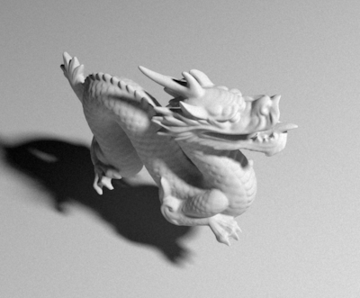
Faster Progressive Refinement: Shooting (2/2)
Shooting converges faster than gathering: shoot energy not by iterating sequentially through the columns, but in order from most unshot radiosity to least
estimate of light on all destination patches with only first column shot, while gathering by row from all senders lights up only that row’s patch
iterating over shooter column of brightest emitter lights up all patches reachable by emitter as a zeroth order approximation, improved by each successive emitter
can add decreasing ambient term (goes to 0)
Need to trade-off storing vs. re-computing n x n form factors on-the-fly for realistically large n
e.g., dragon has ~100k polygons, each of which is a patch, yielding about 10,000,000,000 form factors!
form factor computation likely offloaded to GPU
rendering is typically heavily memory bound, so instead of storing all n x n naïvely/explicitly, recalculate on-the-fly and focus on optimizing form factor calculation
computing all n form factors for a given (sender) patch can be reduced from O(n²) to O(n) by using a single hemicube over that patch (shown next)
11/28/2012
Notes:
29

Slide 30
Details on Shooting (1/4)
In gathering, each row of matrix (I – D(ρ)F) represents estimate of receiver patch i’s radiosity B_{i} based on estimates of all other sender patch j radiosities
contribution of each sender patch j to each receiver patch i (so no E )is:
therefore,
For shooting, shoot from patch j to each receiver patch i in turn; same equation:
for a given shooter j, distribute its unshot radiosity among all receiver patches i
Given an estimate of B_{j} from shooter patch j, we can estimate its impact on all receiving patches i, at the cost of computing F_{i-j} for each receiver patch i, i.e., via n hemicubes erected over each of n receiver patches i
But that is too much work – we can do better…
11/28/2012

Slide 31
Details on Shooting (2/4)
Pseudocode for shooting algorithm so far
computing a single form factor F_{i-j} takes O(n) because it involves projecting all n patches onto the hemicube over patch i (note for F_{i-j}, hemicube is constructed over patch i, thinking of it momentarily as the sender to patch j)
object occlusion calculation is performed by hemicube projection (z-buffer)
cannot pick and choose which patches we project onto hemicube because a patch we did not consider may occlude one or more patches we do consider
therefore, constructing a hemicube involves n projections and z-buffer comparisons even if we are only interested in the contribution (projection) from a single patch
must compute n projections for each of the n receivers
therefore, even though we only need n form factors for a given shooter j, by placing a separate hemicube over each receiver i (each of which takes O(n)) we end up with O(n²) projections overall
11/28/2012

Slide 32
Details on Shooting (3/4)
Can take advantage of reciprocity relationship of F_{i-j} and F_{j-i} to instead evaluate the original, more natural equation with the form factor from j to i:
This allows us to construct a single hemicube over shooter patch j.
When we have projected all n receivers onto j's hemicube in O(n) time, we can then do the usual calculation (dividing each receiver's cell count by the total number of cells) for all n form factors in that shooter's column, updating each receiver in turn.
Thus, only a single hemicube and its n projections need to be computed for each shooter!
11/28/2012

Slide 33
Details on Shooting (4/4)
Original pseudocode for shooting algorithm
Revised pseudocode for shooting algorithm
calculating F_{j-i} is O(1) in inner loop because projection of receiver patch i onto hemicube over shooter patch j has already been performed as part of outer loop!
note that for a given shooter j, we loop through all receiving patches i. Given our notation for the form factor matrix, holding j constant and looping through all i corresponds to traversing a column.
See shooting vs. gathering applet: http://www.cs.brown.edu/exploratories/freeSoftware/catalogs/lighting_and_shading.html
11/28/2012

Slide 34
Radiosity as an Approximation to the Rendering Eqn. (1/2)
Why does this algorithm work as an approximation for the rendering equation?
First need to turn integral into a summation since Radiosity is a discrete process:
Note: we use f_{D} instead of f, because we need a BRDF for patches, not for infinitely small points
We thus need the integral of point BRDFs over entire area of patch to formulate a discrete BRDF
But for radiosity BRDF function in continuous domain is just a constant f₀ since all surfaces are perfectly diffuse
Integrating f₀ over patch is similar to integrating the differential form factor over hemisphere:
11/28/2012

Slide 35
Radiosity as an Approximation to the Rendering Eqn. (2/2)
Due to inverse falloff and visibility terms, the geometry function in the discrete domain is now:
Now let’s combine the BRDF and geometry terms:
The combined BRDF and Geometry term make the form factor equation F_{i-j}
This makes the new (approximated) rendering equation look like:
Radiosity is simply a discrete version of Kajiya’s rendering equation with a constant BRDF for all surfaces
11/28/2012

Slide 36
Limitations of Radiosity
Assumption that radiation is uniform in all directions
Only handles diffuse inter-object reflection
Assumption that radiosity is piecewise constant
usual renderings make this assumption, but then do Gouraud shading
this introduces quantifiable errors
Computation of form factors F_{i-j} can be tough, especially with intervening surfaces, etc.
No volumetric objects
i.e. smoke, fire
(though there are equations and algorithms for calculating surface-to-volume form factors)
No transparency or translucency
Independence from wavelength – no fluorescence or phosphorescence
Independence from phase – no diffraction
Size of matrices! For large scenes, 100K x 100K matrices are not uncommon (shooting reduces need to have it all memory resident)
11/28/2012

Slide 37

More Comments
Even with these limitations, it produces lovely pictures
Using the shooter technique, we can compute the solution iteratively in O(n) space complexity but still O(n²) time complexity.
Tangent: This is a lot like
The Google search engine uses a system much like radiosity to rank its pages
Site rankings are determined not only by the number of links from various sources, but by the number of links coming into those sources (and so on)
After multiple iterations through the link network, site rankings stabilize
Site importance is like luminance, and every site is initially considered an “emitter”
11/28/2012

Slide 38
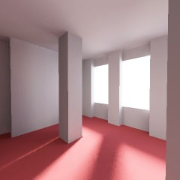
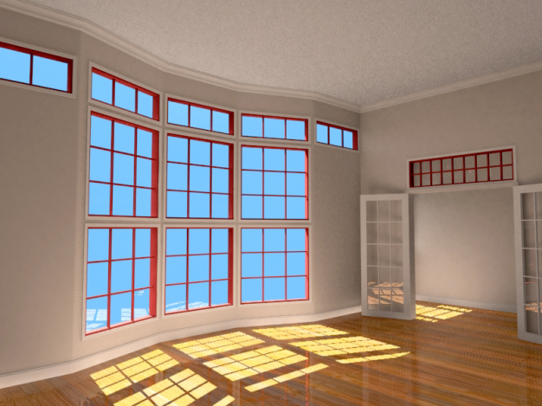
Making Radiosity Fast (1/3)
One approach is importance driven radiosity: if I turn on a bright light in the graphics lab with the door open, it’ll lighten my office a little…
…but not much
By taking each light source and asking “what’s illuminated by this, really?” we can follow a “shooting” strategy in which unshot radiosity is weighted by its importance, i.e., how likely it is to affect the scene from my point of view
No longer a view-independent solution, but much faster
11/28/2012

Slide 39
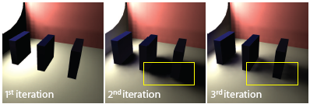
Making Radiosity Fast (2/3)
Towards real-time radiosity:
main bottleneck is computing visibility, V_{ij}
hard to make GPU-friendly
break up radiosity into two sub-passes:
First pass – all light passes through objects as though they were transparent (no occlusion or shadows).
Second pass – account for occlusion implicitly by having every surface emit incident light backwards as negative light or antiradiance; then propagate antiradiance through normal radiosity methods.
11/28/2012
http://www-sop.inria.fr/reves/Basilic/2007/DSDD07/

Slide 40
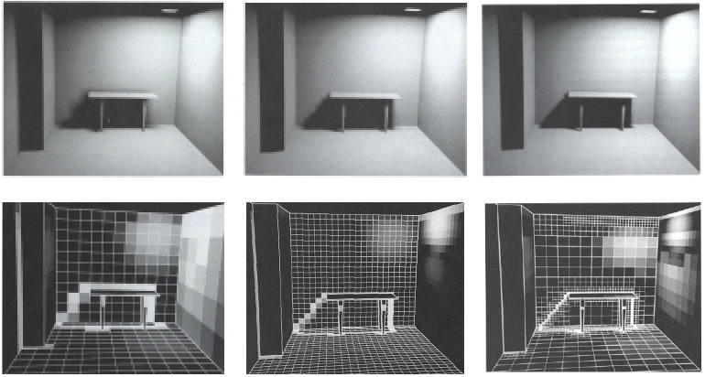
Making Radiosity Fast (3/3)
Radiosity depends on breaking up surfaces into patches
what size patches are best?
too large ⟹ blocky artifacts
too small ⟹ slower computation
Adaptive Patches
smaller patches in high frequency regions
Note slight differences in table’s shadow
Computation is non-trivial
Large patches
Small patches
Adaptive patches
11/28/2012

Slide 41
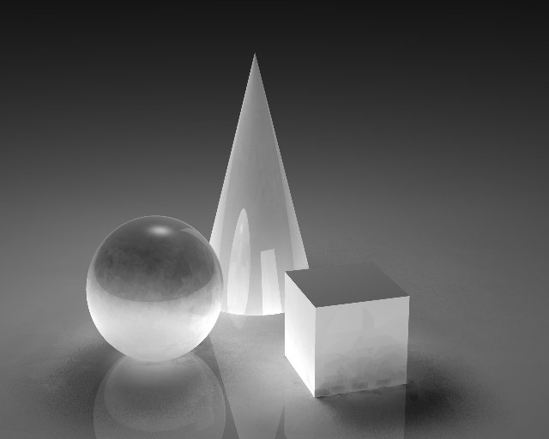
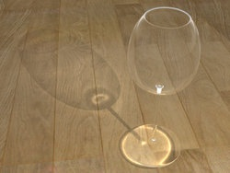
Combining Radiosity with Ray tracing
Radiosity is perfect for diffuse reflection, but doesn’t handle specular
Ray tracing perfect for specular, but doesn’t handle diffuse
Combining the two methods seems like an attractive compromise, however it proves to be more difficult than one would think
Look in the book on a more detailed description
Raytracing + Radiosity
Photon Mapping
11/28/2012

Slide 42
Monte Carlo Methods
A randomized algorithm is an algorithm which relies on sampling from a probability distribution
“stochastic” as opposed to “deterministic”
Two classes of randomized algorithms
Monte Carlo algorithm: running time is deterministic, but there is some probability that the output is erroneous
Las Vegas algorithm: always produces the correct answer, but the runtime is not guaranteed to be finite—instead, the expected runtime should be good.
Monte Carlo integration is a Monte Carlo method for estimating complicated integrals
11/28/2012

Slide 43
Monte Carlo Integration (1/2)
Kajiya’s rendering equation
Radiosity computes the integral by discretizing the domain and then computing an iterative sum
Monte Carlo integration computes the integral by evaluating the function at a finite number of samples and averaging the results.
Variance of estimates will be high if function has high variance (unfortunately true for most realistic scenes)
Specular spike in BRDF
Visibility term is a step function
Samples are taken by performing ray-casting
Good
Fair
Poor
11/28/2012

Slide 44
Monte Carlo Sampling (2/2)
At world-intersection point, compute illumination by
First construct a hemisphere centered at i
Then, shoot ray towards luminaires to capture direct illumination
Finally, shoot rays through random points on the surface of the hemisphere and for rays that hit objects, evaluate the BRDF and add it to the direct illumination
Captures indirect illumination
Does this simple approach produce good results?
only if you are really patient: Nong’s first attempt was a 30 min extension to standard ray tracing
variance from the sampled estimates manifests as noise in the resulting image
we can reduce the variance by taking more samples (~1000 rays is not uncommon for complicated scenes)
Clever rendering algorithms find ways to reduce variance using spatial coherence and effective caching
11/28/2012

Slide 45
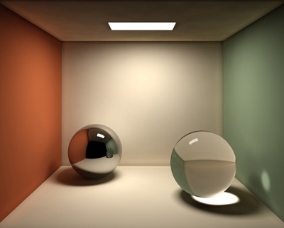
Photon Mapping
Caustics: effect achieved when light is concentrated in an area due to reflection/ refraction (often seen at bottom of swimming pools)
Diffuse Color Bleeding!
Soft Shadows
Caustics!
Specular Reflection/Refraction!
Image credit: Alex Rice
11/28/2012

Slide 46
Photon Mapping
Algorithm developed by Henrik Wann Jensen¹
Two-pass rendering technique combining forward- and back-mapping concepts
Assume that indirect illumination is fairly smooth over small regions and a density estimate of how bright the region is will be good enough
Basic idea: Forward map, then back map
Forward map: shoot rays from light sources in random directions
When a ray hits a point, compute the incoming light energy and store it. Call the energy packet a “photon” and the data structure used to store it a “photon map”
Use a spatial acceleration data structure (like a kd-tree) as the photon map
Back map: once all photons are collected, raytrace scene and use nearby photons to compute indirect illumination
1 Realistic Image Synthesis Using Photon Mapping
11/28/2012

Slide 47
Photon Mapping Considerations
Since photons are shot randomly into the scene, some areas may be under-represented.
Especially noticeable with caustics
Solution
Split photon map into a “diffuse” photon map and a “caustic” photon map. Caustic map receives photons that passed through an object during its journey; diffuse map receives everything else.
Each map has a minimum photon count to guarantee many caustic photons are collected.
Both maps are sampled during the rendering pass.
11/28/2012

Slide 48
Photon Mapping Considerations
A rendering algorithm is unbiased if averaging infinitely many passes of the algorithm computes the solution to the Kajiya lighting equation
As the number of averaged results approaches infinity, error approaches zero
Individual passes may have relatively high error
A rendering algorithm is consistent if it computes the lighting equation exactly when sample size approaches infinity
Photon mapping is biased but consistent
Consider a photon map containing a single photon. Each pass will have negligibly small amount of indirect lighting, so average of infinitely many passes will too. The algorithm is therefore biased.
However, if the number of photons stored in the map approaches infinity, the technique produces the solution to the lighting equation. Intuitively, shooting infinitely many photons in random directions simulates nature.
Large photon maps are needed to produce good results. Other techniques (e.g. path tracing) use less memory but may take longer to produce appealing images.
11/28/2012

Slide 49
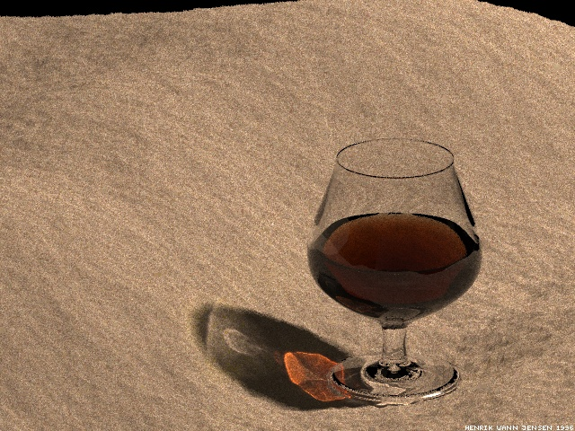
Photon Mapping and the Lighting Equation
Photon mapping efficiently handles indirect diffuse illumination and transmitted specular reflections (caustics).
Combined with raytracing (for direct illumination and specular reflections), photon mapping provides a good approximation to the Kajiya Lighting Equation
Image Credit: Henrik Wann Jensen
11/28/2012

Slide 50
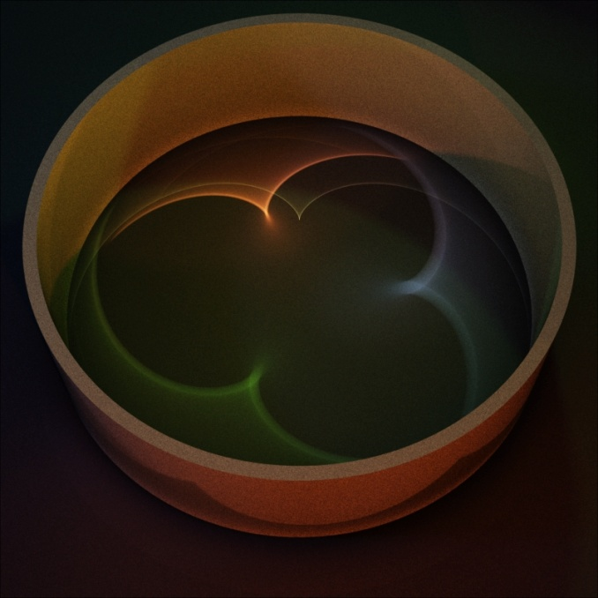
What is MLT? (1/3)
Metropolis Light Transport: type of Monte Carlo algorithm
Monte Carlo rendering algorithms randomly sample every path which a light ray can take in the world
based on ray casting
point sampling of complete rendering equation
uses a combination of techniques to reduce sampling variance
in general, capable of much more complicated effects than radiosity and classical ray tracing combined
able to render scenes that are “difficult”
Hall of mirrors
11/28/2012

Slide 51

Pretty Enough to Look At Again…
11/28/2012

Slide 52
What is MLT? (2/3)
Integrates Kajiya’s Lighting Equation using importance sampling
Instead of taking uniformly spaced samples across the domain of a function, take more samples in regions that are more important
if we already know something about a function, we can utilize this knowledge
sample more in areas which contribute more to final value of the integral
Metropolis sampling is a variety of importance sampling (Metropolis, Rosenbluth, Rosenbluth, Teller, and Teller, 1953)
chooses samples in such a way that they are eventually distributed proportionally to the value of the function being integrated
Metropolis Light Transport¹ algorithm reformulated integral rendering equation as a pure integration problem over space of all light paths
we want to know all light paths that begin at an emitter and end at the camera
1 Veach, SIGGRAPH 97 Proceedings (August 1997), Addison-Wesley, pp. 65-76
11/28/2012

Slide 53
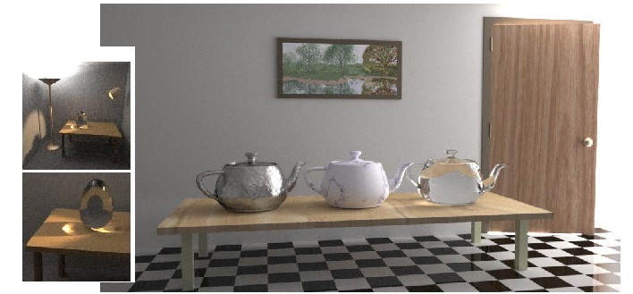
What is MLT? (3/3)
Final Image =
contribution of a single path
Conceptually:
where P is space of all possible light paths
For complicated scenes, these paths can be difficult to find
MLT amortizes the cost of finding these paths
After the algorithm finds a successful path, it will have a high probability of perturbing that path locally
Resulting path is therefore also likely to contribute to the image
often much faster than previous Monte Carlo methods
This scene is entirely lit from a source behind the door.
11/28/2012

Slide 54
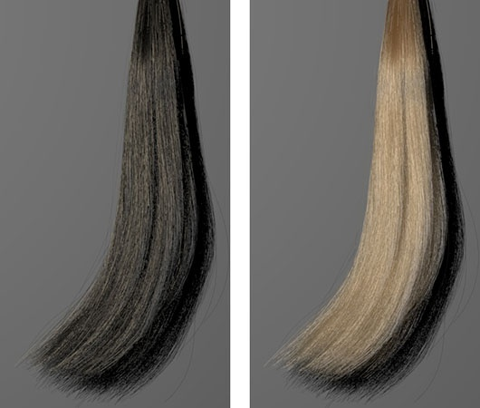
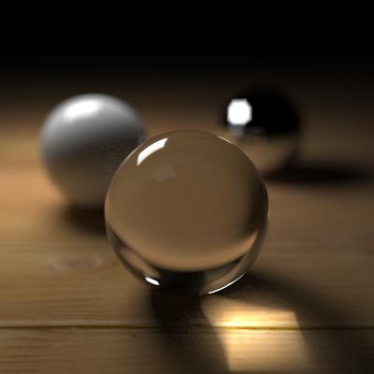
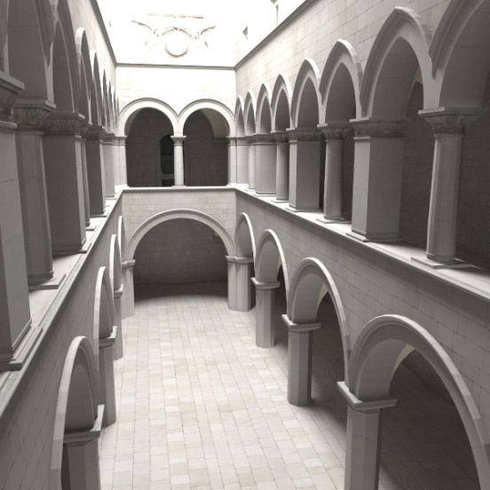
MLT vs. Photon Mapping
Both really good
Both generate caustics, diffuse bleeding, specular lighting contributions
Photon mapping converges faster
Less sampling in order to generate results
Less statistical computational overhead
Similar to shooting vs. gathering in Radiosity
MLT is much better at indirect lighting
Light path mutations cluster around ‘important’ light contributions
Photon mapping blindly sprays photons randomly
11/28/2012

